Slide 1
Manipulation of DNA- 3

Slide 2
Artificial Restriction Enzymes
Notes:
ZFNs and TALENs are very nicely explained in the link given below (section-Genome Editing in Somatic Cells Using Zinc Finger Nucleases and Transcription Activator-Like Effector Nucleases)
https://www.sciencedirect.com/topics/biochemistry-genetics-and-molecular-biology/foki
https://www.labome.com/method/CRISPR-and-Genomic-Engineering.html

Slide 3
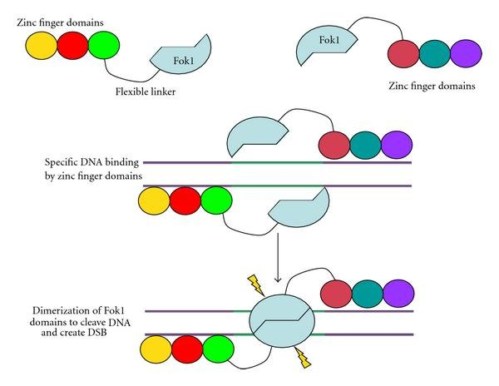
ZINC FINGER NUCLEASES
Basic structure and design of a zinc finger nuclease (ZFN). ZFNs are created by joining a DNA-binding region to the catalytic domain of the nonspecific Fok1 endonuclease. Zinc fingers are a protein motif capable of DNA binding, whose sequence specificity can be predetermined. Each zinc finger, illustrated by an individual circle, recognizes 3-4 nucleotides, and, by assembling three or four suitable zinc finger motifs, a sequence-specific DNA-binding domain can be created. Fok1 nuclease activity requires dimerization, and so the customized ZFNs function in pairs. As shown, the zinc finger-binding domain brings two Fok1 units together in the right orientation over the target sequence; this induces Fok1 dimerization and target sequence cleavage.
Notes:
FokI is a dimeric-type IIS restriction enzyme isolated from Flavobacterium okeanokoites, which recognizes the 5′-GGATG-3′ sequence and introduces two single cuts 9nt away from the 3′ end of its recognition sequence on the top strand (listed above) and 13nt away from the 5′ end of the bottom strand sequence (complementary to the listed one), thus collectively creating sticky ends with 4nt-long overhang.

Slide 4
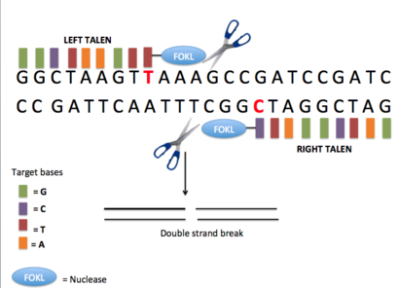
Transcription Activator-like Effector Nucleases (TALENs)
Transcription activator-like effectors (TALEs) are DNA-binding domains that can be linked together modularly and fused with nuclease domains to create TALE nucleases, or TALENs
Notes:
The DNA-binding domain used for TALENs is derived from transcription activator-like effectors (TALEs), which are naturally occurring proteins injected into host plant cells by Xanthomonas spp. bacteria. Once inside, TALEs bind to genomic DNA to alter host cell transcription facilitating the pathogenic colonization by the bacteria (Boch and Bonas, 2010).
Transcription activator-like effectors (TALEs) are DNA-binding domains that can be linked together modularly and fused with nuclease domains to create TALE nucleases, or TALENs [72]. Each TALE has a repeat of 34 amino acids and recognizes a single base pair on the DNA target molecule. Therefore, several TALEs must be linked together to create a protein that recognizes a specific DNA sequence. As with ZFNs, two arrays are used to target a nuclease to a DNA sequence, and each array binds one half-site target (Figure 3). TALE arrays are primarily fused to Fok1 nuclease domains, which cleave DNA within the spacer region between the two half-sites. ZFN and TALENS are both modular and have natural DNA-binding specificities. They differ in that ZFN's single zinc finger domains recognize three base pairs, and TALE domains recognize just one base pair. This difference does make it easier to create TALEN systems that recognize more target sequences. One benefit of TALENs over ZFN’s for genome editing is that they exhibit less toxicity in human cell lines and zebrafish [73]. Another benefit of TALENs is a higher rate of genome editing success via cytoplasmic injection of TALEN mRNA in livestock embryos than occurs with ZFN induction

Slide 5
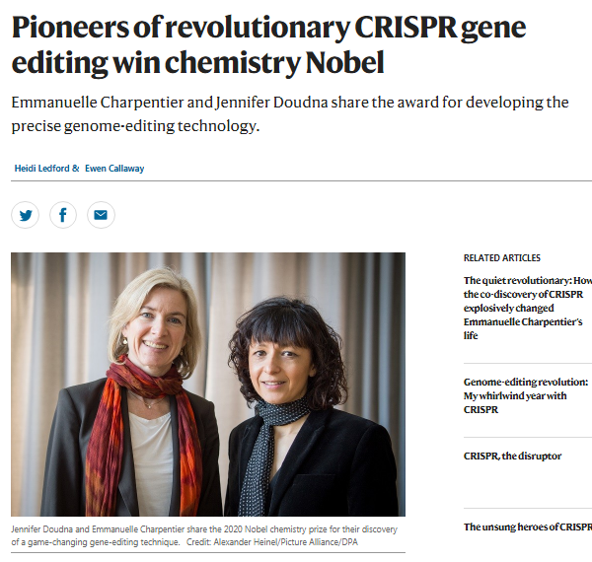
https://www.nature.com/articles/d41586-020-02765-9

Slide 6
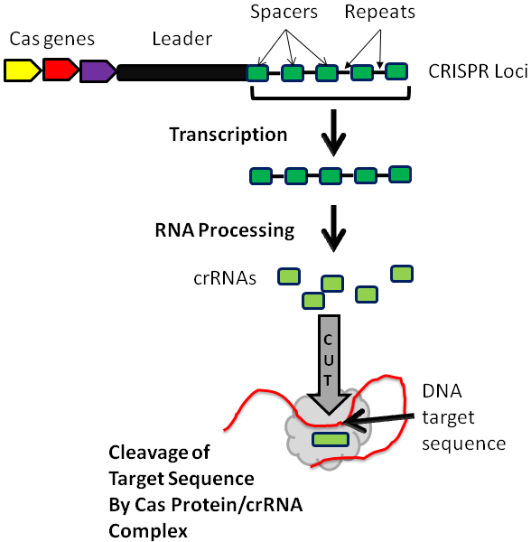
CRISPR (clustered regularly interspaced short palindromic repeats) is a family of DNA sequences found in the genomes of prokaryotic organisms such as bacteria and archaea. These sequences are derived from DNA fragments of bacteriophages that had previously infected the prokaryote
The CRISPR loci include Cas genes, a leader sequence, and several spacer sequences (in green) derived from engineered or foreign DNA that are separated by short repeat sequences (in black). Individual mature CRISPR RNA (crRNAs) are created by processing of the CRISPR transcript. Cas proteins and the crRNA make an effector complex that recognizes a target nucleic acid sequence via complementary base pairing to the crRNA. Cleavage of the target sequence occurs and is followed by DNA repair by the endogenous cellular repair machinery.
Notes:
CRISPR are genomic loci composed of short DNA repeats with spacer sections interspersed (Figure 2). Originally observed in E. coli [8], these loci have been found in a variety of Archaea and bacterial genomes. CRISPR loci acquire fragments of foreign DNA from phages or plasmids, which are inserted within their repeat sequences [12]. The foreign integrated DNA sequences aid the cell in recognizing and targeting foreign DNA in future attacks [13]. That CRISPR-Cas systems work via RNA interference was first proposed by Makarova et al in 2006 [12], and later supported by many reports, and reviewed by members of the same group [14].
CRISPR loci include repeats, spacers, a leader sequence and CRISPR-associated genes (Cas) [9]. There are several different Cas genes, which produce proteins with varying functions including endonuclease, helicase, nucleic acid binding and transcription regulation [15]. CRISPR-Cas systems are classified into several types [16]. Type II CRISPR systems are the simplest and have the fewest number of associated genes, which include the nuclease cas9, as well as the proteins cas1, and cas2. Some Cas proteins process the CRISPR gene product [9] into mature CRISPR RNA (crRNA) and transactivating crRNA (tracrRNA) molecules. The crRNA is complementary to a target sequence, normally a foreign nucleic acid segment derived from a virus or conjugative plasmid. Together, CRISPR RNAs and Cas proteins form a complex that recognizes the foreign or target nucleic acid sequence and causes its degradation. This system provides RNA-based immunity against foreign DNA [17-19]. CRISPR-Cas systems can lead to the degradation of both target DNA and target RNA, depending on the CRISPR loci and the type of Cas proteins involved [20, 21]. More recently, P Pausch et al identified a single 70 kD CasΦ protein using the same active site for both CRISPR RNA processing and crRNA-guided DNA cutting from bacteriophages [22].
The Type II CRISPR/Cas system has been utilized for directing sequence-specific targeting of novel nucleic acid targets. This system includes the Cas9 nuclease, a non-coding tracrRNA and a pre-crRNA array that includes sequences that guide nuclease targeting. It was reported by Jinek et al that the Cas9 nuclease can be guided to a novel DNA target for cleavage by engineering a synthetic guide RNA (sgRNA), which replaces the two RNAs normally found in the CRISPR-Cas system (CRISPR RNA or crRNA and transactivating crRNA or tracrRNA).
For those who are interesting in knowing how bacteria protects its own DNA from CRISPR
https://www.sciencedaily.com/releases/2015/04/150413130825.htm

Slide 7
For Zinc Finger Nuclease
https://www.youtube.com/watch?v=iGmq1O6mIy0
For transcriptional activator-like effector nucleases (TALENs)
https://www.thermofisher.com/in/en/home/life-science/genome-editing/geneart-tals.html
For CRISPR
https://www.youtube.com/watch?v=MnYppmstxIs
https://www.livescience.com/58790-crispr-explained.html
For ethical concerns read this news
https://www.sciencemag.org/news/2019/12/chinese-scientist-who-produced-genetically-altered-babies-sentenced-3-years-jail
Notes:
https://www.labome.com/method/CRISPR-and-Genomic-Engineering.html

Slide 8
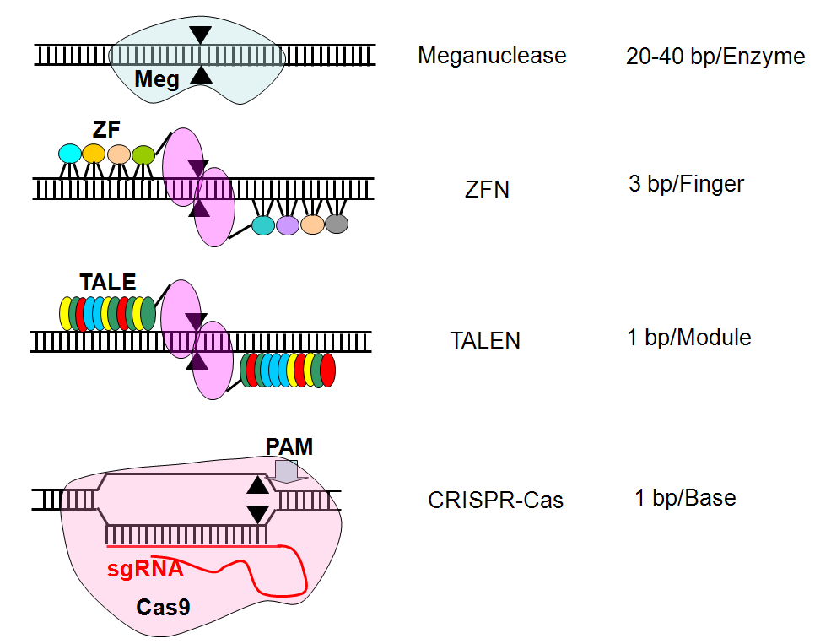
Notes:
Meganucleases, found commonly in microbial species, have the unique property of having very long recognition sequences (>14bp) thus making them naturally very specific.[17][18] However, there is virtually no chance of finding the exact meganuclease required to act on a chosen specific DNA sequence. To overcome this challenge, mutagenesis and high throughput screening methods have been used to create meganuclease variants that recognize unique sequences.[18][19] Others have been able to fuse various meganucleases and create hybrid enzymes that recognize a new sequence.[20][21] Yet others have attempted to alter the DNA interacting aminoacids of the meganuclease to design sequence specific meganucelases in a method named rationally designed meganuclease.[22] Another approach involves using computer models to try to predict as accurately as possible the activity of the modified meganucleases and the specificity of the recognized nucleic sequence.[23]

Slide 9
